Slide 1
The Intricacies of Compliance
Rising Expectations
Jack Jared Managing Director, Correspondent Banking Group Business Compliance and Risk

Slide 2
Agenda
Money Laundering – the scope
Cost of Non-Compliance
Global AML Governance Program
A Look at Citi’s Strategy

Slide 3
Money Laundering – What is it?
The attempt to make ill-gotten gains appear legitimate by the movement of funds to conceal the true source, ownership or use and of the funds. The source of the funds may include criminal activities such as drug trafficking, arms sales, embezzlement, extortion, ransom.
The use of legitimate money for illegitimate purposes (e.g. terrorist financing). The motivation behind terrorist financing is generally ideological, as opposed to profit-seeking.
Although the estimates of criminal proceeds and related financial crime are substantial, money launderers conceal the true nature of their activities and illicit finance is comingled with the trillions of dollars processed by financial institutions each day.
$1.6 trillion | Conservative estimate of global money laundering according to UN office of Drugs and Crime. (2009)
$1 trillion | World Bank estimate of annual worldwide bribery.
$320 billion | UN estimate of global illegal narcotics trade.
$39 billion | International Labor Organization estimate of Human Trafficking value.
$30 million | CIA’s estimate of Al-Qaeda's annual budget.
1.5 million | Number of Suspicious Activity Reports filed in the U.S. in 2012. (FinCEN)

Slide 4
Stopping illicit money flows is a national security imperative. Global banks have global responsibilities to prevent participation in illicit or suspect transactions.
Carl Levin, December 2012

Slide 5
Getting Global Regulatory Attention
US
European Union
Department of the Treasury
Office of the Comptroller of the Currency
Financial Crimes Enforcement Network
Office of Foreign Asset Control
European Commission
Bank for International Settlements
Non Governmental Bodies
Regional Governmental Regulators
United Nations
Financial Action Task Force (FATF)
Transparency International
Global Witness
World Bank
Monetary Authority of Singapore
The People’s Bank of China
Attorney’s General Department (Australia)
Council of Financial Activities Control (Brazil)
Financial Monitoring Committee (Russia)

Slide 6
Hot AML Regulatory Topics
Compliance Risk Management/Controls
Correspondent Banking
Nested Relationships
Funds flow between high risk geographies (originator/beneficiary)
Client documentation
Affiliates and Branch networks
Remittance payments/MSB’s
Stored Value Cards (Pre-paid)
Increased coordination across regulatory agencies—inside US and US across other jurisdictions
Senior Public Figures/ Politically Exposed Persons (PEPS)
Virtual Currency

Slide 7
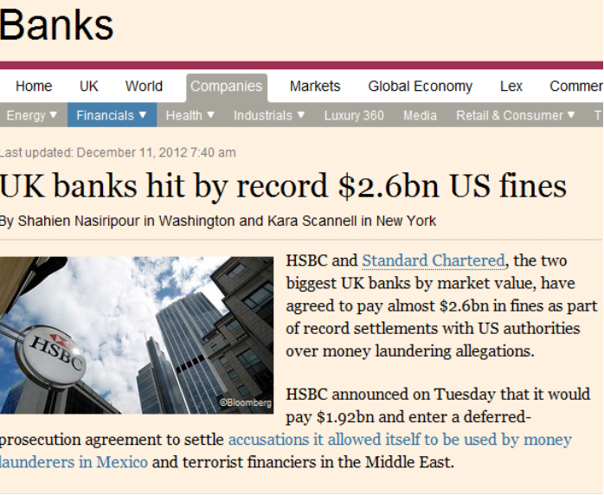
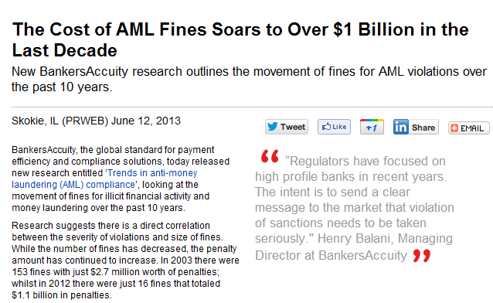
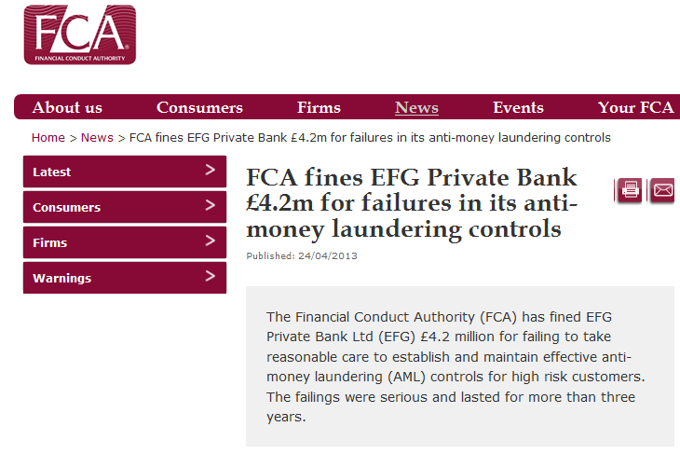
If you think Compliance is expensive, try non-compliance

Slide 8

The fine from regulators is the easy part…
Attention from other Regulators
Reputational damage
Increased headcount
Consultancy fees
Loss of partners, clients
Increased technology budget
Long periods of Regulatory oversight

Slide 9
AML Program Governance
AML Governance should be Global, Cross sector and Cross Functional
Board Level
Oversees management's implementation of a strong global AML Program
Global Governance and Risk
Provides strategic direction and drives execution of the AML Program in the businesses
AML Steering Committees
Ensures management prioritizes the requirements of the AML Program and provides resources and information as may be necessary to complete implementation of regulatory commitments and other enhancements
Business Level
Ensures AML program requirements are properly executed and AML risks are monitored and controlled
9

Slide 10
Citi’s Global AML Program
Objectives
Protect Citi by preventing, detecting and reporting money laundering, terrorist financing and other illicit activities
Manage AML risk in an integrated manner across products, business lines and geographies supported by globally consistent systems and processes
Meet regulatory obligations and expectations
Mitigate legal, financial, compliance and reputational risk
Citi’s Bank Secrecy Act / Anti-Money Laundering Program
AML Lifecycle
Prevention
Know Your Customer
Detection
Monitoring & Investigations
Reporting
Feedback Loop, Account Restrictions and Closures
Governance & Enterprise-wide Controls
Legal Requirements
AML Program is “risk based” and must include:
A system of internal controls
Independent testing of AML Compliance
Designation of an AML Compliance Officer
Training for appropriate personnel
Policies:
Define standards
for conduct
Processes:
Oversight and measurement
Personnel:
Sufficient levels, appropriate skills and training
Controls:
Effectiveness, testing and manage project execution

Slide 11
AML Lifecycle
Prevention
Know Your Customer
Detection
Monitoring & Investigations
Reporting
Feedback loop
Customer Risk Scoring
Transaction
Monitoring/
Alerts
Case
Review
Escalations
Suspicious Activity Reporting (SARs)
Customer
On-boarding
Customer Maintenance
Investigations
Currency Transaction Reporting (CTRs)
Global Investigations
(Inputs from internal and external sources)
Name Screening
(Sanctions, Red Flag, Senior Public Figure)
Account Restrictions and Closures
Governance and Enterprise-wide Controls
Policies
Processes
Personnel
Controls
Policies & Standards
Procedures
Governance & Management
Issues Management
Risk Assessment
Metrics / Analytics
Staff / Talent
Training & Communications
Roles and Responsibilities
Program Management
Compliance Testing
Independent Testing

Slide 12
Governance and Enterprise-wide Controls
Policies
Processes
Personnel
Controls
Timely and accurate completion of KYC due diligence and periodic review requirements;
Responds to transaction monitoring and investigation case inquiries
Roles and Responsibilities
Defines standards; provides advice on regulatory requirements and expectations; provides guidance on client and product risk
AML
Compliance
Manages transaction monitoring Hubs
Provides support for MANTAS and case management systems testing and implementation
Business
AML Operations
Primary ownership for development and production of the Risk Assessments, Metrics and Analytics
Compliance and Architecture Strategy
Citi’s BSA/AML Program
Defines and maintains the technology strategy for AML
Implements and maintains environment controls, including data quality and completeness
AML
Technology
Manages projects, related issues and escalations and reporting
Oversees the IMR process
Provides financial and third party management
Internal Audit
Compliance Testing
Conducts testing of AML program and processes
AML Plan Implementation
Meets the regulatory requirement to conduct independent testing of the AML program
Note: Additional roles within the organization provide advice, expertise and are complementary to the roles shown above.

Slide 13
Thank you

Slide 15
声明：
所有的版权属于原有公司，文件均来自公开渠道
此文件仅供学习使用，任何人不得进行以此为商业目的的行为
如有疑问，请立即删除
学习世界五百强和咨询公司PPT课程请访问如下网站搜索：“司马懿”
百度传课：司马懿PPT学校
https://www.chuanke.com
网易学堂：司马懿PPT学校
https://study.163.com
知乎： 司马懿PPT学校
https://www.zhiu.com

